Slide 1
A Heterogeneous Accelerator Platform for
Multi-subject Voxel-based Brain Network Analysis
Yu WANG, Mo XU, Ling REN, Xiaorui ZHANG, Di WU, Yong HE, Ningyi XU, Huazhong YANG
Joint work by Tsinghua Univ., Beijing Normal University, and Microsoft

Slide 2
Outline
Background and Motivation
  What is the brain network
Platform and Algorithm
  Why and how we design accelerators
Results
Conclusion and future work
  What we can do next

Slide 3

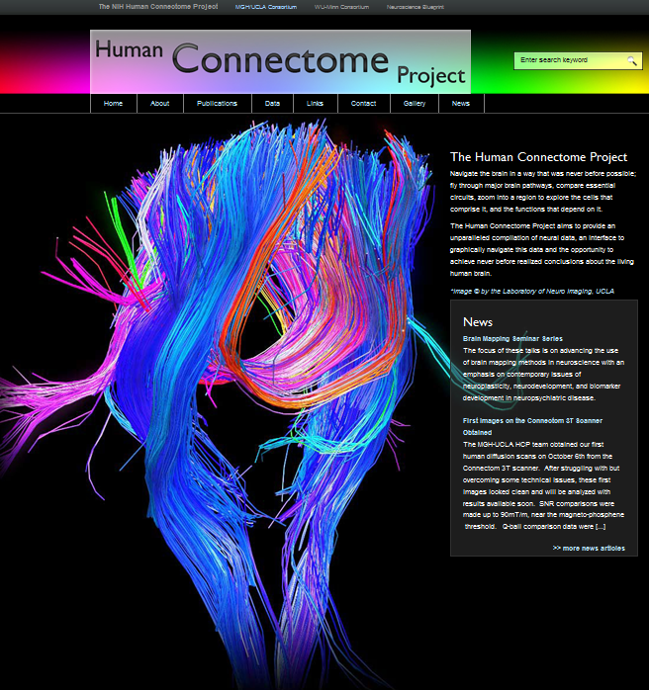
Understanding the Brain
One of the greatest scientific challenges of 21st century
  NIH Human Connectome Project
Human Genome Project (HGP 1990-2003)
http://humanconnectome.org/
Human Connectome:
Mapping structural and functional connectivity in the human brain
5 years, $30 million, 2 consortiums, 4+ universities/hospitals, for the basic analysis method and acquiring data
Notes:
Understanding the human brain is very interesting and challenging. It is regarded as one of the great scientific challenges of the 21st century.
Neuroscience research focuses on deciphering the brain connectivity.
Illustration:
NIH HCP, 5 years, $30 million, two consortiums, four universities.
aims at mapping structural and functional connectivity in the human brain.
build the Connectome database and the Connectome Workbench visualization platform.

Slide 4
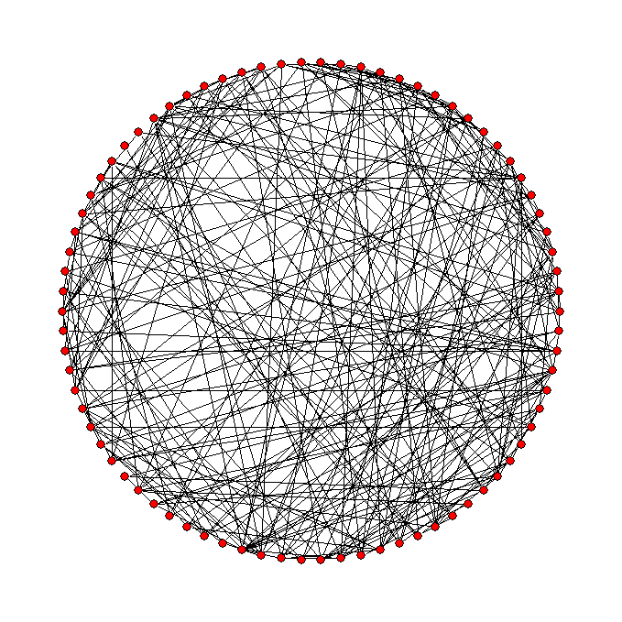
What are brain networks?
What is a network?
  Nodes and connections are two basic elements of a network.
A network
(graph)
What are the nodes and connections of brain networks and how do we define them?
How many types of brain network s are there according to scale, physiology, and anatomy
Notes:
So we are looking at the brain network, the brain network is also a network. The fundamental elements…
We have two question here, what is the basic elements in a brain network, how many types?

Slide 5
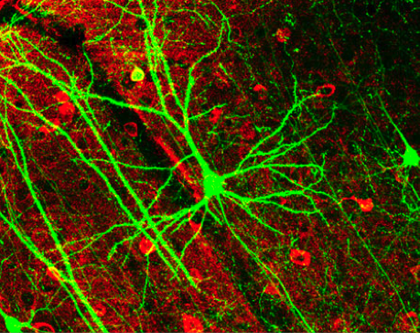
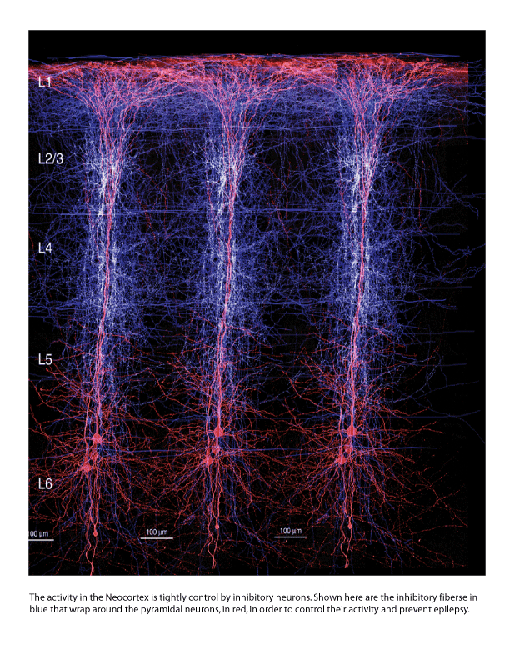
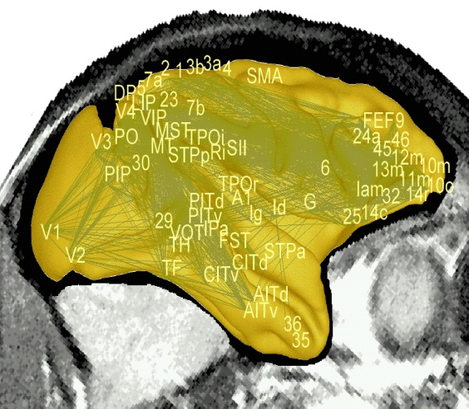
Scales and levels of brain networks
Basic structure of brain networks (node and connection) can be defined at different scales.
Microscale: neurons and their synaptic connections (about 10¹⁰ neurons in the cortex).
Mesoscale: connections within and between minicolumns (about 2×10⁸ minicolumn in the cortex ).
Macroscale: anatomically distinct brain regions and inter-regional pathways (about 100 regions in the cortex).
Voxel based Brain network Analysis
Basic elements can be derived from Medical Imaging Techniques
Scale:
10K-100K
Neurons
Columns
Regions
Sporns et al (2005) PLoS Comput Biol
Notes:
First of all, the types of brain networks can be categorized by the scale

Slide 6
Types from physiology and anatomy
Basic types of brain networks can be described in terms of physiology and anatomy.
  Functional brain networks:
    Functional connectivity: temporal correlation between spatially remote neurophysiological events (Friston, Hum Brain Mapp 2004).
    Effective connectivity: causal effects of one neural system over another (Friston, Hum Brain Mapp 2004).
  Structural brain networks:
    Structural connectivity: physical or structural (synaptic) connections linking neuronal units (Sporns et al., Trends Cogn Sci 2004).
    Morphometric connectivity: statistical interdependencies of morphological features between different brain regions such as the cortical thickness, gray matter volumes, density, areas and complexity (He et al., Neuroscientist, 2009).
Notes:
From the physiology and anatomy, divided into two kinds of brain networks, the first is functional and the other is structural. The ones I will mention in this talk includes the functional connectivity and the morphometric connectivity
Blood density is different

Slide 7
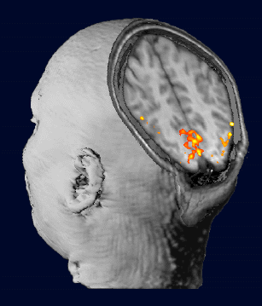
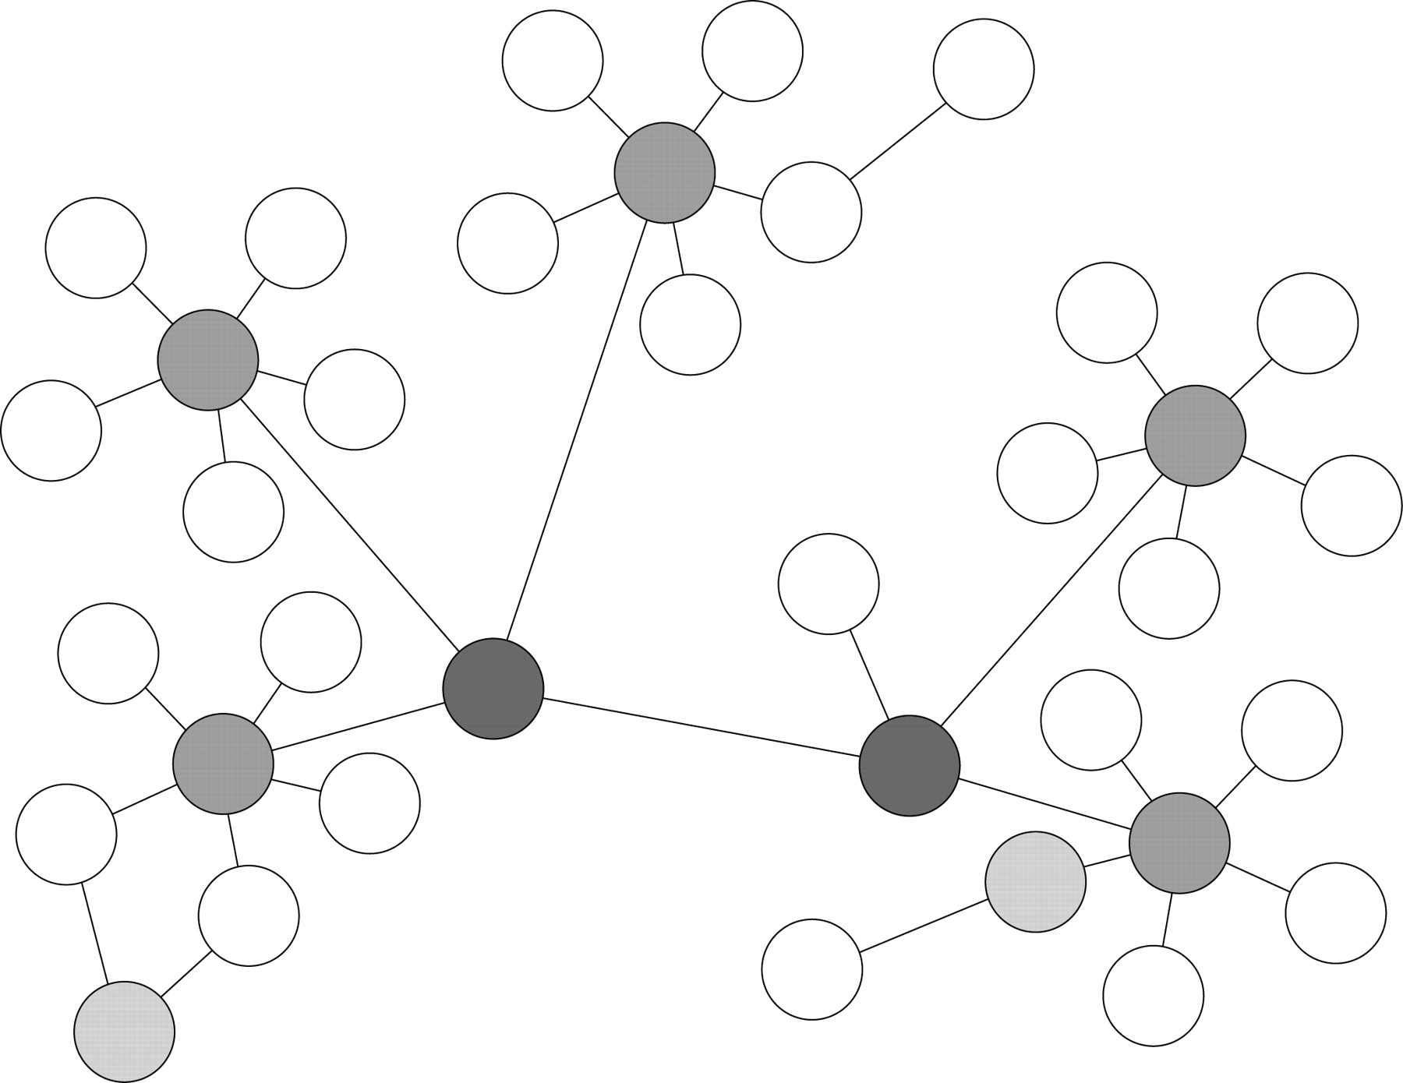
Brain Network Analysis (BNA)
Non-invasive technique: Medical Imaging
Imaging techniques + Graph theory
  functional MRI, diffusion tensor MRI, structural MRI, …
Reveal the properties of the brain
  Small world, Scale free [Heuvel 2008]
  Efficiency
  Modular structure [Valencia 2009]
  …
Understand the mechanism of brain diseases
  Alzheimer’s disease [He 2008; Supekar 2008; Lo 2010]
  Schizophrenia [Bassett 2008; Zalskey 2010; Liu 2008]
  Depression [Zhang 2011]
  …
Notes:
Model the brain as a network (to study the connectivity)
Method: MRI → network, + graph → network analysis
1. functional MRI -> functional connectivity
used to measure the hemodynamic response (change in blood flow) related to neural activity in the brain or spinal cord of humans or other animals.
2. diffusion tensor MRI -> structural connectivity
produces in vivo images of biological tissues weighted with the local microstructural characteristics of water diffusion, which is capable of showing connections between brain regions.
3. structural MRI -> (out of fashion?)
Cortical thickness measurements
Yield:
1. Study the properties
2. Diagnose diseases

Slide 8
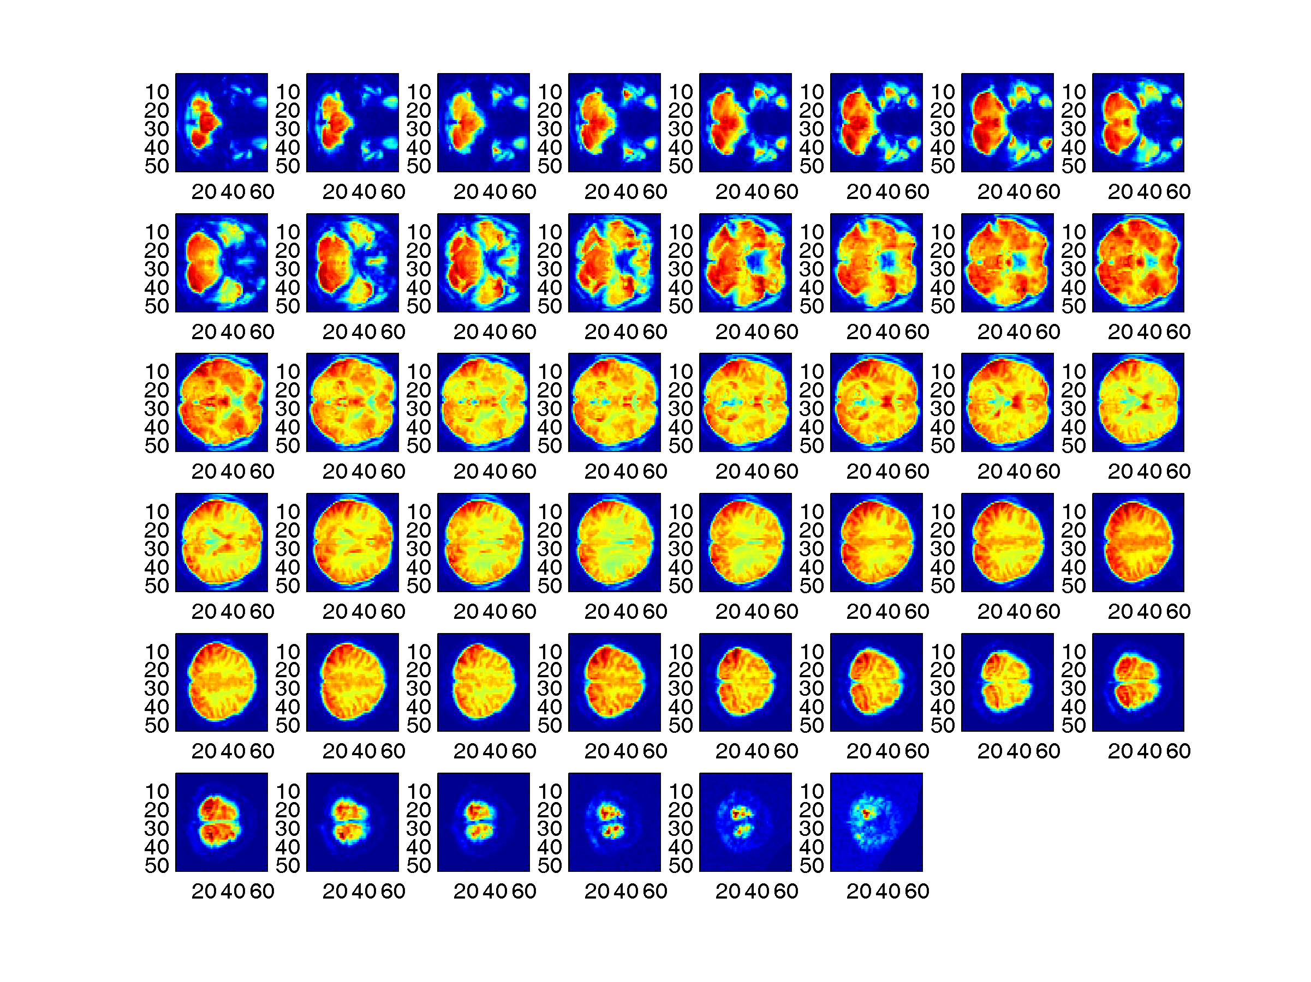
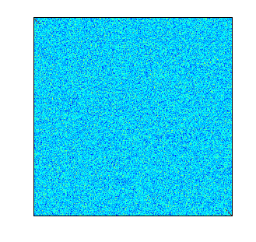
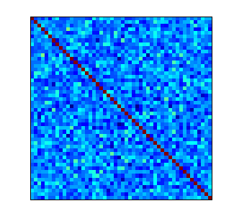
Challenge 1: Voxel-based BNA
Utilize the high resolution of imaging techniques
  Compared with region-based BNA
  2mm * 2mm * 2mm (each pixel)
  10k ~ 100k voxels
Regions
100
Regions
100
Voxels
100K
Voxels
100K
Notes:
Voxel based vs. region based.
Finer-grained,
1. reflects more information acquired from high resolution scan
2. Not biased by predefined anatomical structures
3. Take into account intra-region connections
We use fMRI as a case study.
dtMRI is future work.

Slide 9
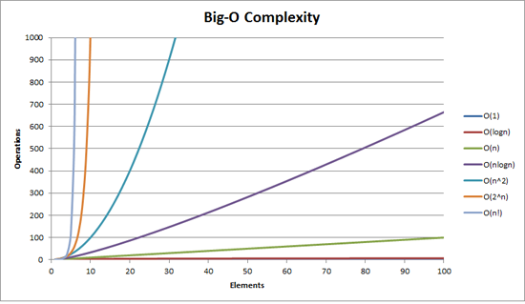
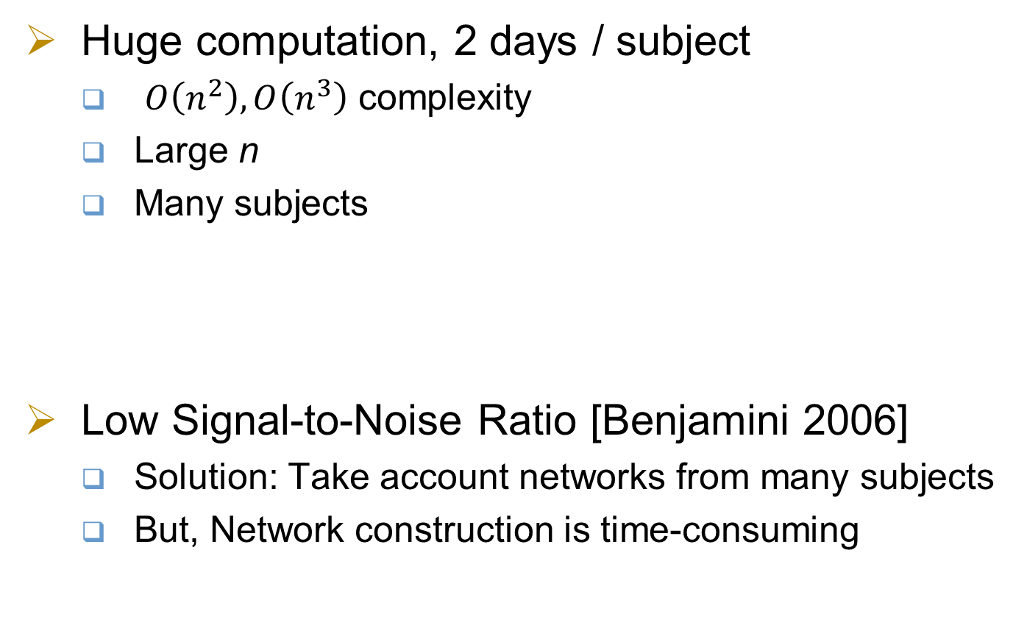
Challenge 2: Multi/Many Subjects
Huge computation, 2 days / subject
  $O\left(n^{2}\right),O\left(n^{3}\right)$ complexity
  Large n
  Many subjects
Low Signal-to-Noise Ratio [Benjamini 2006]
  Solution: Take account networks from many subjects
  But, Network construction is time-consuming
Notes:
Voxel based BNA faces two main challenge:
1. Computation (and storage)
Reason:
large data,
complexity of graph theory algorithms,
in addition, many subjects
2. Relatively low SNR
Solution:
Average/t-test
new challenge:
Aggregate the computation

Slide 10
What we need
Computing platforms and techniques that should be
  Efficient
    Huge computation
  Scalable
    Increasing network size
  Affordable (infrastructure and power)
    Can be used in hospitals
Notes:
We need high performance hardware and software
Feature:
Fast
Scalable
Cheap
(low power consumption, small size)

Slide 11
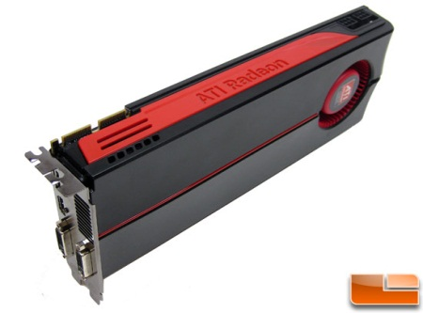
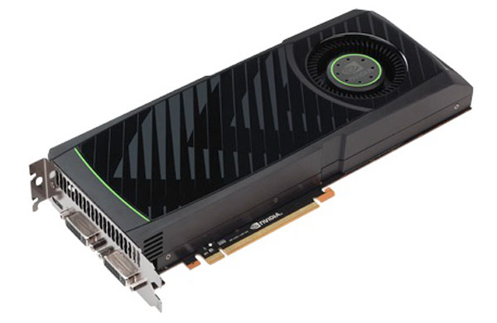
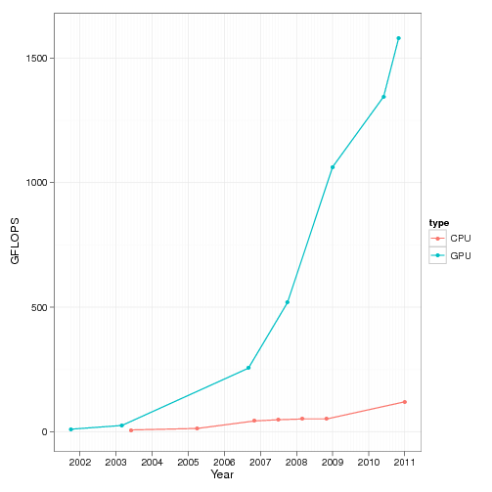
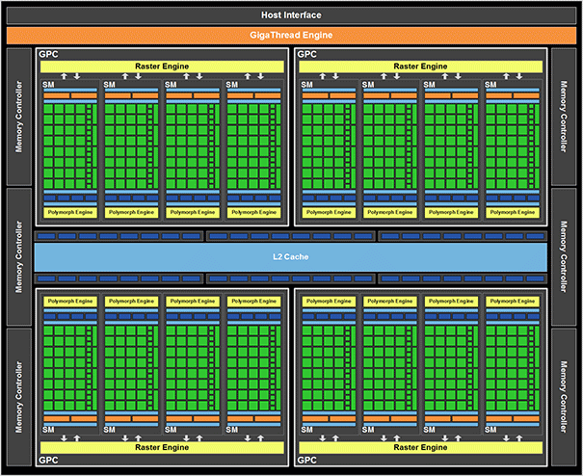
GPGPU
Hardware
  Many-core
  SIMD model
For massive data-parallel computation
  High throughput
  Low cost
Notes:
GPGPU is suitable for BNA,
Since the parallelism of algorithms, and GPU’s SIMD architecture.
We need map the software onto the software.

Slide 12
Outline
Background and Motivation
Platform and Algorithms
Results
Conclusion and future work

Slide 13
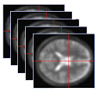
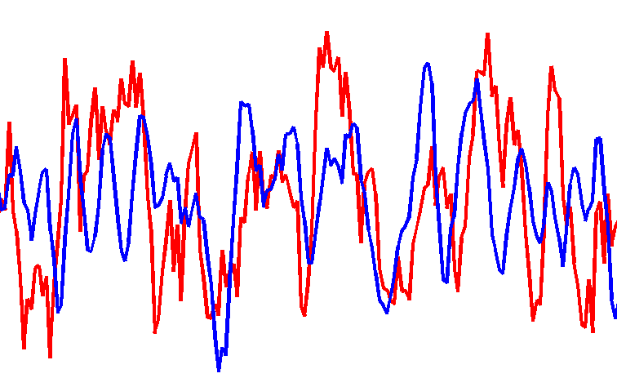
Platform Overview
http://parabna.weebly.com/
Functional MRI
Time series
Our focus:
GPU part:
Notes:
The work flow of our platform.
There are four steps: data acquisition, image preprocessing, network construction and network analysis.
We accelerate the latter two steps (shown in detail in the two blocks at the bottom).
In network construction, correlation matrices for each subjectare are obtained by calculating Pearson Correlations.
These correlation matrices are then"binarized" into one single adjacency matrix, by simply averaging or using t-test.
In the network analysis step, several charateristics are calculated. Procedures denoted by green (i.e. Pearson Correlation, Partition and APSP) are accelerated with GPU.
All procedures are implemented with multi-core CPU.

Slide 14
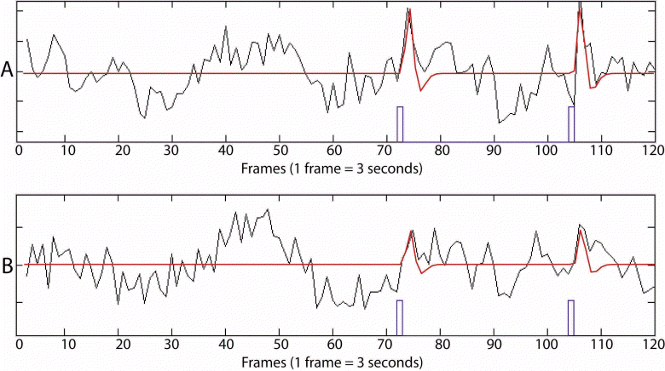
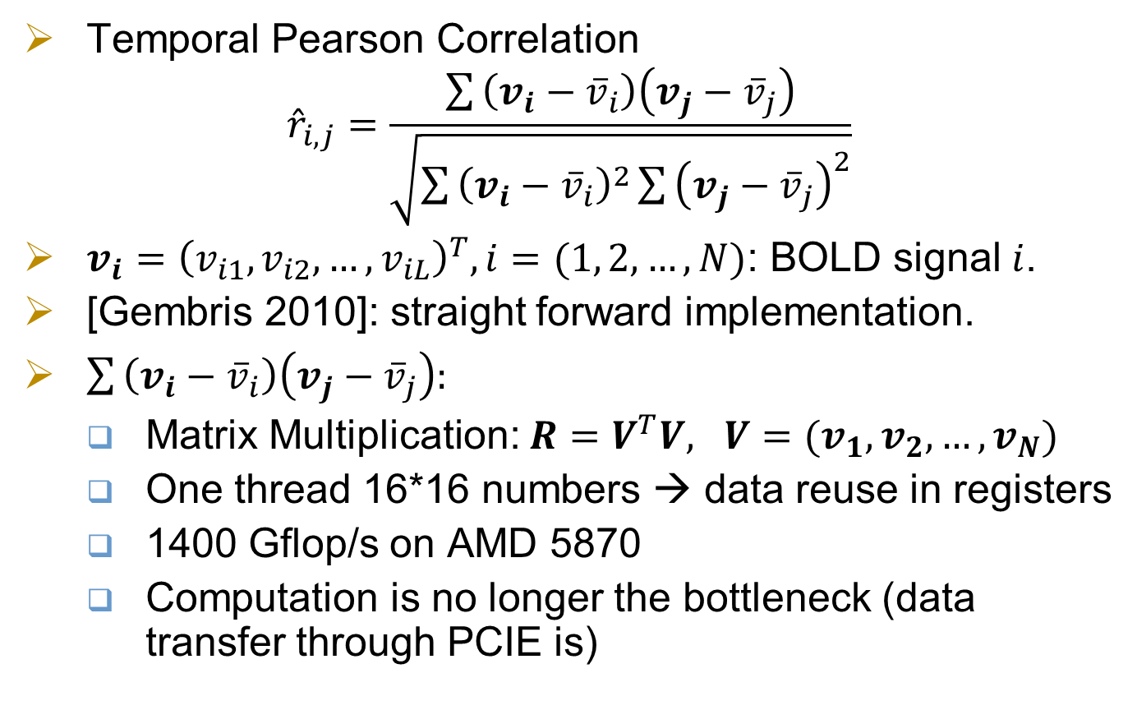
Network Construction
Temporal Pearson Correlation
$${\hat{r}}_{i,j}=\frac{\sum{‍}\left(v_{i}−{\overline{v}}_{i}\right)\left(v_{j}−{\overline{v}}_{j}\right)}{\sqrt{\sum{‍}{\left(v_{i}−{\overline{v}}_{i}\right)}^{2}\sum{‍}{\left(v_{j}−{\overline{v}}_{j}\right)}^{2}}}$$
$v_{i}={\left(v_{i1},v_{i2}, …, v_{iL}\right)}^{T}, i=(1, 2, …,N)$: BOLD signal $i$.
[Gembris 2010]: straight forward implementation.
$\sum{‍}\left(v_{i}−{\overline{v}}_{i}\right)\left(v_{j}−{\overline{v}}_{j}\right):$
  Matrix Multiplication: $R=V^{T}V, V=(v_{1}, v_{2}, …,v_{N})$
  One thread 16*16 numbers → data reuse in registers
  1400 Gflop/s on AMD 5870
  Computation is no longer the bottleneck (data transfer through PCIE is)
Notes:
The first step in the work flow is the correlation calculation.
The input is BOLD signals of length L for each of the Nv voxels.
The output is the connectivity matrix. We then binarize it to get the adjacency matrix.
Thus we obtain the brain network.
Previous work didn’t identify the matrix multiplication kernel…
Tennessee University reports 1.4 TFLOPS on AMD 5870…

Slide 15
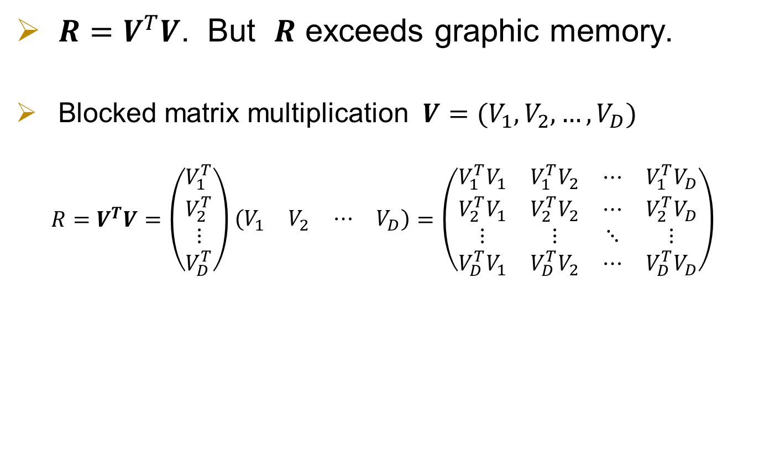
Network Construction - scalability
$R=V^{T}V$. But $R$ exceeds graphic memory.
  Blocked matrix multiplication $V=(V_{1}, V_{2}, …,V_{D})$
  $$R=V^{T}V=\left(\begin{matrix}V_{1}^{T} \\ V_{2}^{T} \\ ⋮ \\ V_{D}^{T}\end{matrix}\right)\left(\begin{matrix}V_{1} & V_{2} & ⋯ & V_{D}\end{matrix}\right)=\left(\begin{matrix}V_{1}^{T}V_{1} & V_{1}^{T}V_{2} & ⋯ & V_{1}^{T}V_{D} \\ V_{2}^{T}V_{1} & V_{2}^{T}V_{2} & ⋯ & V_{2}^{T}V_{D} \\ ⋮ & ⋮ & ⋱ & ⋮ \\ V_{D}^{T}V_{1} & V_{D}^{T}V_{2} & ⋯ & V_{D}^{T}V_{D}\end{matrix}\right)$$
CPU time (s) | GPU time (s) | Speedup
245.8 | 2.0 | 123x
Notes:
The first step in the work flow is the correlation calculation.
The input is BOLD signals of length L for each of the Nv voxels.
The output is the connectivity matrix. We then binarize it to get the adjacency matrix.
Thus we obtain the brain network.
Previous work didn’t identify the matrix multiplication kernel…
Tennessee University reports 1.4 TFLOPS on AMD 5870…

Slide 16
Network Construction
Adjacency matrix
  undirected, unweighted
  Used in subsequent analysis
Multiple correlation matrices
→ one adjacency matrix
  Averaging + thresholding
  Possible alternative: t-tests
Notes:
The first step in the work flow is the correlation calculation.
The input is BOLD signals of length L for each of the Nv voxels.
The output is the connectivity matrix. We then binarize it to get the adjacency matrix.
Thus we obtain the brain network.
Previous work didn’t identify the matrix multiplication kernel…
Tennessee University reports 1.4 TFLOPS on AMD 5870…

Slide 17
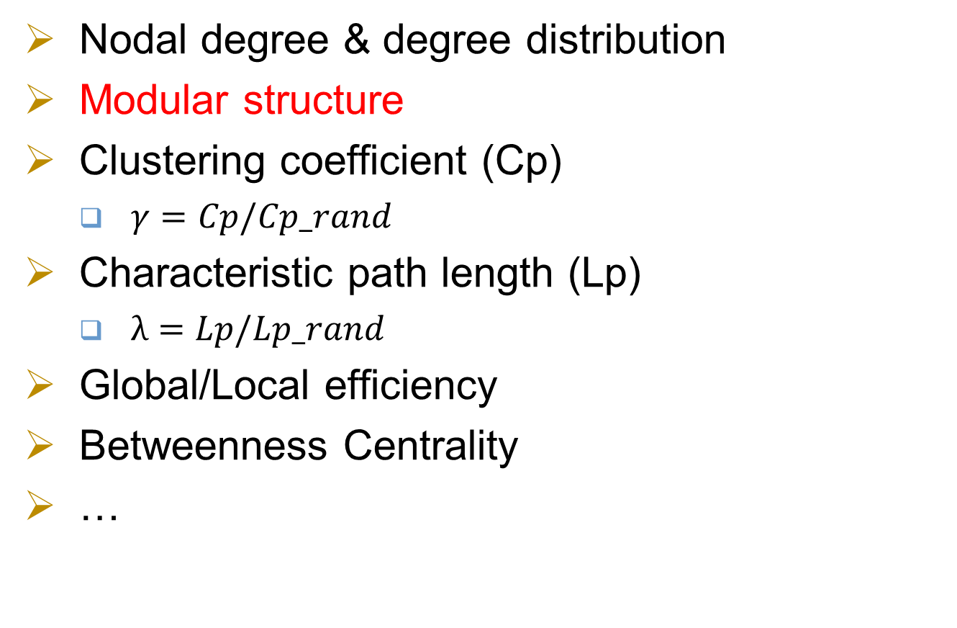
Network Analysis
Nodal degree & degree distribution
Modular structure
Clustering coefficient (Cp)
  $γ=Cp/Cp_rand$
Characteristic path length (Lp)
  $λ=Lp/Lp_rand$
Global/Local efficiency
Betweenness Centrality
…
Scale free
Compared with random networks
Small world
APSP
Notes:
From the brain network, we can calculate some informative characteristics such as the nodal degree, the clustering coefficient (Cp), the characteristic path length (Lp), the local and global efficiency (LE and GE), and so on.
These characteristics reveal interesting properties of brain networks such as the small world property and the scale free property.
Lp, LE and GE rely on the calculation of All-Pairs Shortest Path (APSP), which is one of the most time-comsuming step in voxel-based BNA.
Brain networks also have the community strucure. Community detection (or modular detection, partition) is another time-consuming step in BNA.

Slide 18
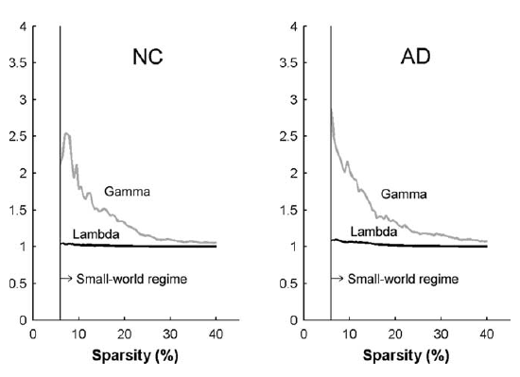
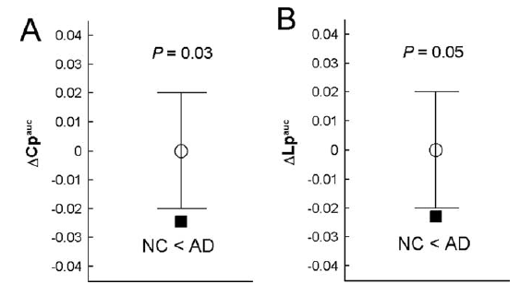
Understand the brain by BNA
Alzheimer's Disease [He 2008]
  Abnormal small-world architecture
AD patients showed abnormal small-world architecture in the structural cortical networks (increased clustering and shortest paths linking individual regions), implying a less optimal topological organization in AD.
92 AD patients, 97 Normal Controls. Cortical thickness measurement from MRI to form the structural cortical networks. Computing with 1000 random.
Notes:
He also use the cortical thickness measurement from magnetic resonance imaging. By investigating the large-scale structural brain networks in 92 AD patients and 97 normal controls, He found that AD patients showed abnormal small-world architecture in the structural cortical networks (increased clustering and shortest paths linking individual regions), implying a less optimal topological organization in AD.

Slide 19
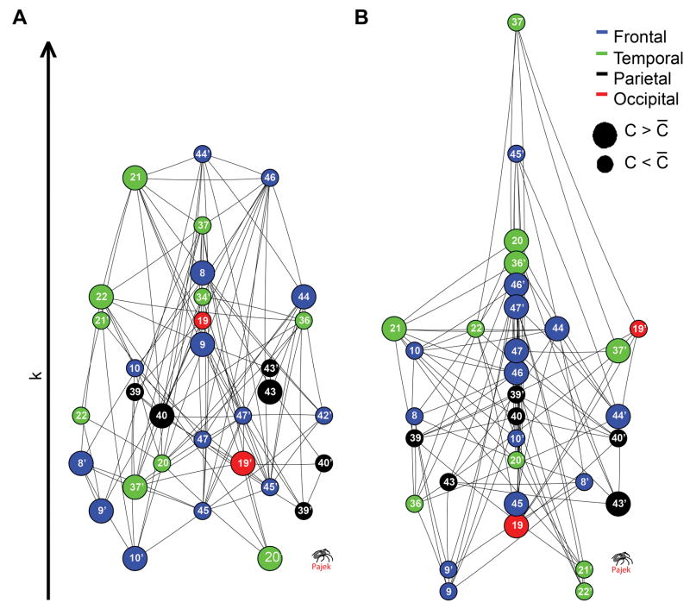
Understand the brain by BNA
Schizophrenia [Bassett 2008]
  Differences in highly clustered nodes
Nodes have large Clustering Co-efficient are different
The topological and distance metrics of anatomical network organization were significantly abnormal in people with schizophrenia. The abnormality is indicated by reduced hierarchy, the loss of frontal and the emergence of nonfrontal hubs, and increased connection distance.
Notes:
http://www.ncbi.nlm.nih.gov/pmc/articles/PMC2878961/
Bassett found that the brain network constructed from the structural MRI data, which measures the cortical thickness, have small-world properties, which are consistent with recent functional MRI analysis, indicating a degree of topological isomorphism between whole-brain structural and functional networks. He also found that the topological and distance metrics of anatomical network organization were significantly abnormal in people with schizophrenia. The abnormality is indicated by reduced hierarchy, the loss of frontal and the emergence of nonfrontal hubs, and increased connection distance.

Slide 20
Modular Detection
Identiﬁes the functionally associated components of the brain
Spectral partition
  More precise
  Demand huge computation
  We make it applicable to BNA
algorithm | Proposed by | Used in BNA
Greedy algorithm | [Newman 2004] | [He 2009]
Random walk | [Pons 2006] | [Valencia 2009]
Spectral partition | [Newman 2006] | Our work
Notes:
There are several modular detection methods that are applicable to un-weighted sparse networks.
A random-walk-based method is introduced in [Pons 2006] , and is used in [Valencia 2009].
A greedy algorithm is presented in [Newman 2004] , and is used in [He 2009].
The algorithm we choose for the detection of Brain Network moduler structure is the eigenvector-based spectral partition method.
This algorithm is more precise but at the same time involves much more computation than the above approximate algorithms.
Our GPU implementation greatly accelerates this algorithm and makes it applicable to very large graphs.

Slide 21
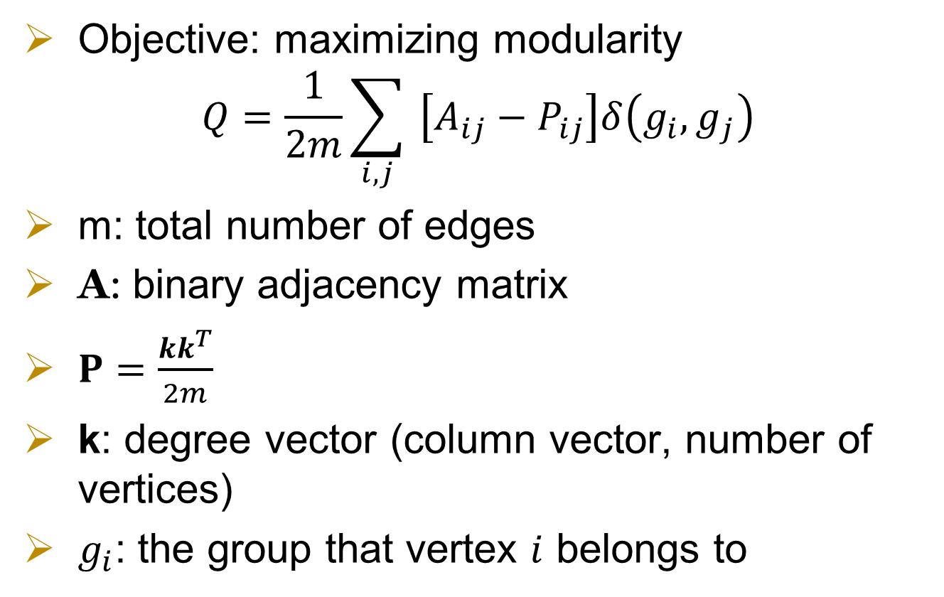
Spectral partition
Objective: maximizing modularity
$$Q=\frac{1}{2m}\sum_{i,j}{‍}\left[A_{ij}−P_{ij}\right]δ\left(g_{i},g_{j}\right)$$
m: total number of edges
A: binary adjacency matrix
$P=\frac{kk^{T}}{2m}$
k: degree vector (column vector, number of vertices)
$g_{i}$: the group that vertex $i$ belongs to
Notes:
The idea of modular detection is to find groups of points that has a lot of inner-group connections and relatively few inter-group connections. A benefit function $Q$ is introduced to judge the network's modularity, which is defined as follow.
where $A_{ij}$ is the element of the binary adjacent matrix representing the Brain Network; $P_{ij}$ is the probability for an edge to fall between every pair of vertices $i$, $j$; $g_{i}$ is defined as the community to which vertex $i$ belongs; $δ\left(g_{i},g_{j}\right)$ is 1 if $g_{i}=g_{j}$ and 0 if otherwise, and $m$ is the number of edges in the network. $P_{ij}$ can be defined as $P_{ij}=\frac{k_{i}k_{j}}{2m}$, where $k_{i}$ is the degree of node $i$.
Then the problem becomes finding the best division $s$ that maximizes $Q$. Newman has proven that the best $s$ can be obtained by the eigenvector $u$ of $B$, a real symmetric matrix called Modularity Matrix, which is defined as,
$B_{ij}=A_{ij}−P_{ij}$
Hence, using the eigenvector corresponding to the most positive eigenvalue of B, we can divide the network into two groups according to the signs of the elements of this eigenvector. Since the Brain Networks are unlikely to have only two communities, a modified algorithm to handle multiple divisions is also described in [newman 2006].
There is also an inner loop inherent in the power method for eigenvector calculation. Hence, the algorithm is fundamentally serial. As a result, it is difficult to migrate the entire algorithm to GPU platform. Instead, we implement a finer granularity acceleration of the algorithm. In each round of iteration, some basic matrix operations, such as sparse matrix vector multiplication and vector addition and multiplication, account for most of the computing time. These operations have to be performed for numerous times, rendering the algorithm extremely slow if running entirely on CPU. But there matrix operations are of high parallelism and thus suitable for GPU implementation. So we use CPU to perform the general scheduling and accelerate the most time-consuming matrix calculations on GPU.

Slide 22
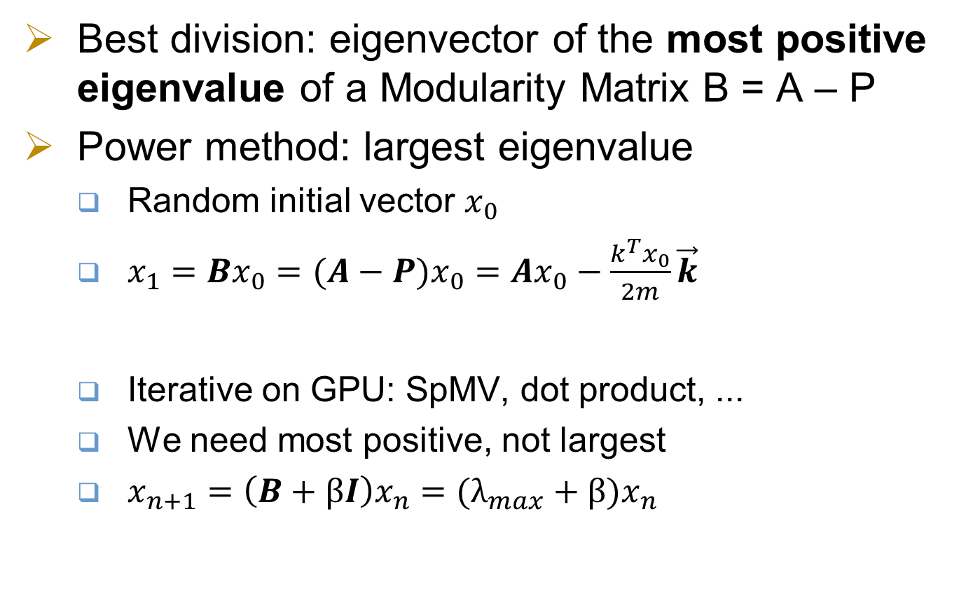
Spectral partition
Best division: eigenvector of the most positive eigenvalue of a Modularity Matrix B = A – P
Power method: largest eigenvalue
  Random initial vector $x_{0}$
  $x_{1}=Bx_{0}=$ $(A−P)x_{0}=$ $Ax_{0}−\frac{k^{T}x_{0}}{2m}\vec{k}$
  Iterative on GPU: SpMV, dot product, ...
  We need most positive, not largest
  $x_{n+1}=\left(B+βI\right)x_{n}=(λ_{max}+β)x_{n}$

Slide 23
Modular Detection Performance
Unit: second
Sparsity | 0.06% | 0.13% | 0.38% | 1.39% | 5.46%
Number of modules | 63 | 25 | 36 | 26 | 20
GPU (s) | 459 | 187 | 473 | 666 | 1346
4-core CPU | 2954 | 947 | 2990 | 5057 | 16690
Speedup | 6.43 | 5.1 | 6.3 | 7.6 | 12.4
1-core CPU | 4889 | 2233 | 8482 | 17624 | 58699
Speedup | 10.7 | 12.0 | 17.9 | 26.5 | 43.6
Notes:
The performance varies along sparsities.
5~10 speedup compared to 4-core CPU
(the single core performance data on paper is wrongly filled with 4-core CPU data…)

Slide 24
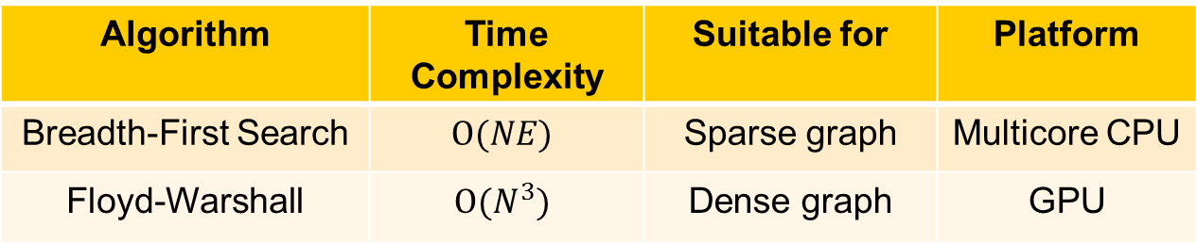
APSP: All Pairs Shortest Paths
Algorithm | Time Complexity | Suitable for | Platform
Breadth-First Search | $$O(NE)$$ | Sparse graph | Multicore CPU
Floyd-Warshall | $$O(N^{3})$$ | Dense graph | GPU
Unweighted graph
Blocked Floyd Warshall [Venkataraman 2000]
  Scalable
  Shared memory efficient
  GPU implementation [Katz 2008]
Notes:
For unwieghted graph, we can use BFS-like algorithm. (different from BFS: not stop when the vertex has been met by other threads). Related to sparsity.
Irregular program, load balance is important.
We implement it on multicore CPU, load balance is achieved by sorting the source points according to nodal degree.
Unlike BFS, Floyd-Warshall’s algorithm (FW) has O(V^3) time complexity, which is irrelevant to the graph sparsity. Blocked FW algorithm is an improved version of FW algorithm. Not only is it more efficient than the basic FW algorithm, it is also more suitable for GPU implementation.

Slide 25



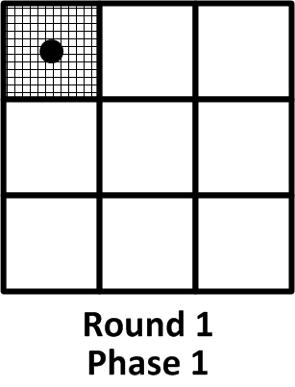
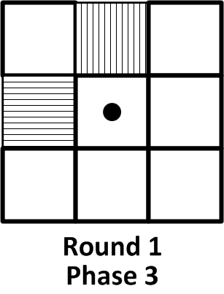
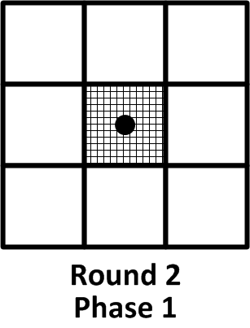
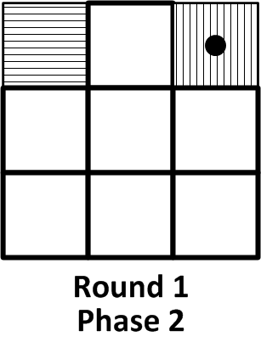
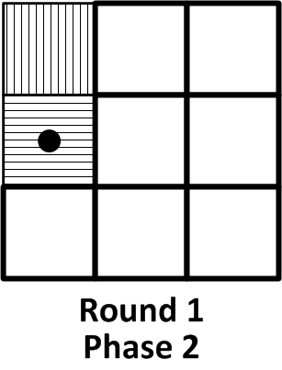
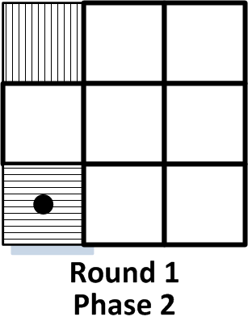
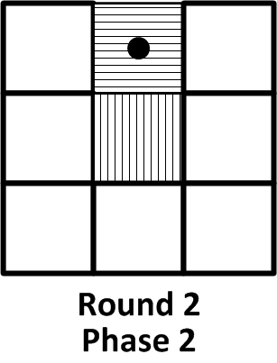
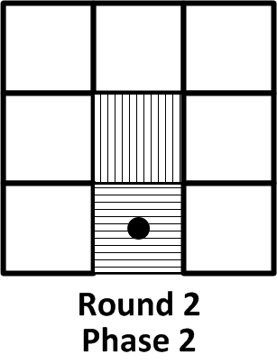
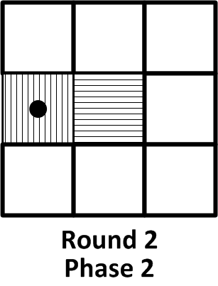
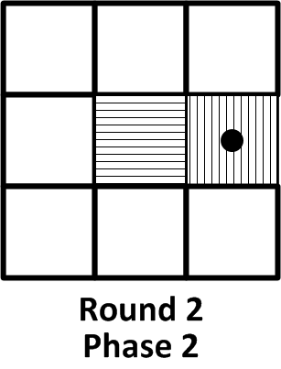
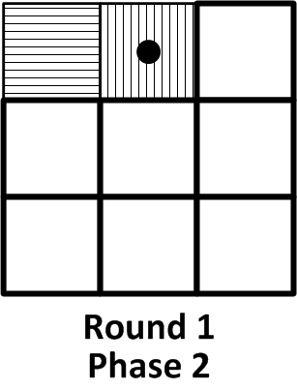
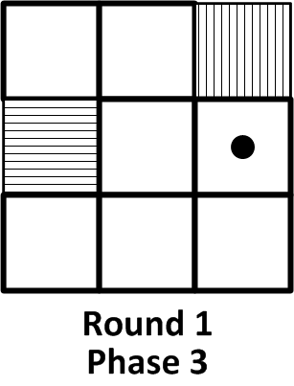
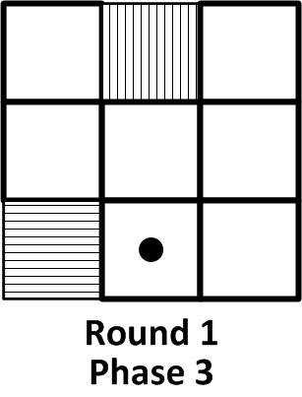
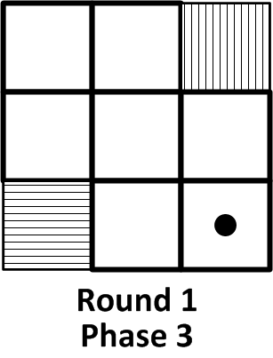
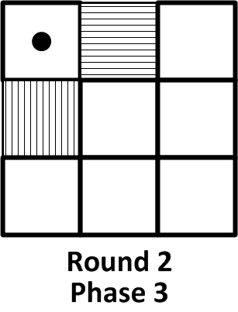
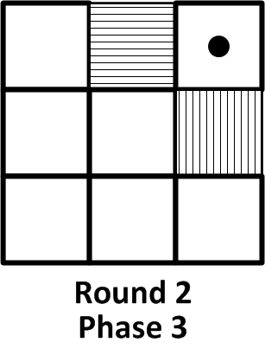
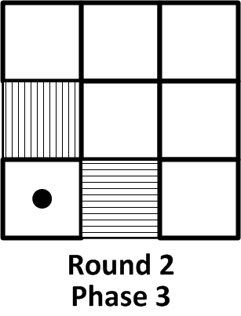
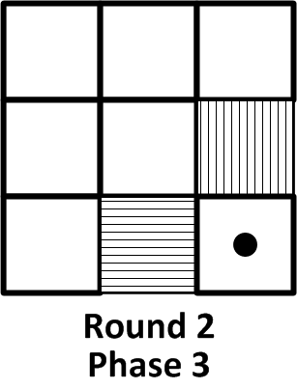
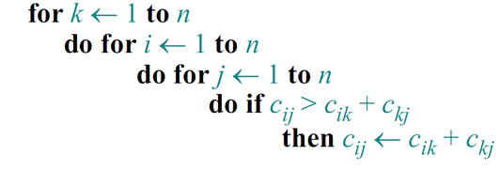
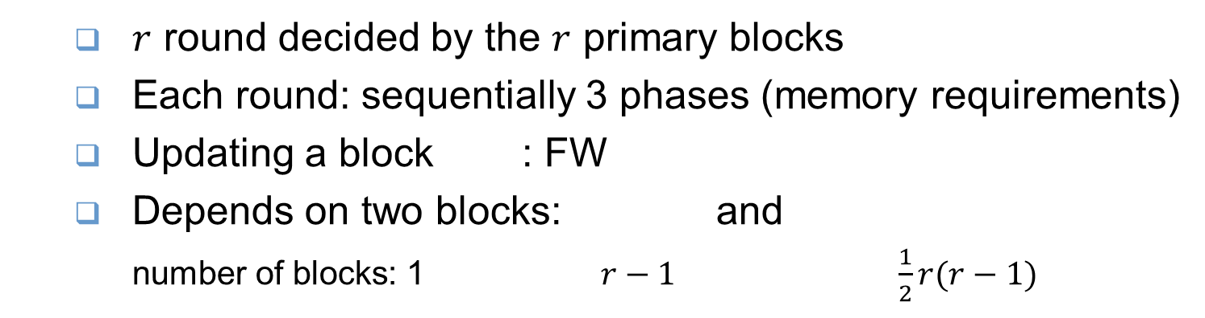
Blocked FW
  $r$ round decided by the $r$ primary blocks
  Each round: sequentially 3 phases (memory requirements)
  Updating a block : FW
  Depends on two blocks: and
    number of blocks: 1 $r−1$ $\frac{1}{2}r(r−1)$
Notes:
the cost matrix is divided into r sub-blocks of equal size.
The outer loop iterates over the r primary blocks (the blocks along the diagonal of the matrix).
In each of the r iterations, all blocks are updated in the similar way with FW Algorithm.
Therefore, in each iteration, updating a block needs 1) the block in the same
column with itself and in the same row with the primary block,
denoted with vertical lines in the Figure, and 2) the block in the
same row with itself and in the same column with the primary
block, denoted with horizontal lines.
According to different memory requirement, one single iteration can be divided into
three phases that are performed sequentially (shown in Fig.2).

Slide 26
Previous implementation [Katz 2008]
1 work-group for 1 block
Enables threads within the work-group
  To synchronize
  To share local memory, faster than global data share
But inefficient with very large networks
  when the entire adjacency matrix cannot be stored on GPU

Slide 27

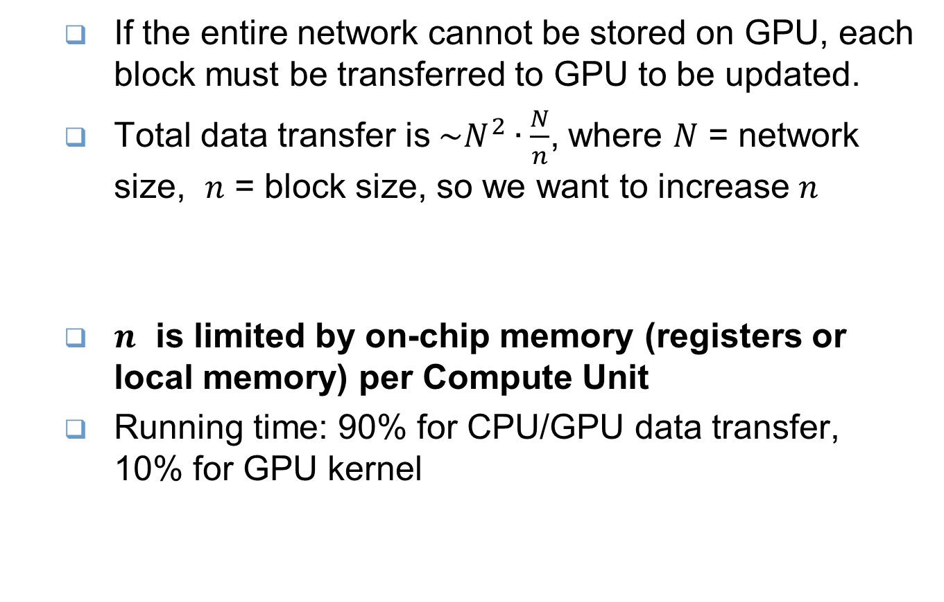
[Katz 2008] for very large network
  If the entire network cannot be stored on GPU, each block must be transferred to GPU to be updated.
  Total data transfer is${\sim N}^{2}∙\frac{N}{n}$, where $N$ = network size, $n$ = block size, so we want to increase $n$
  $n$ is limited by on-chip memory (registers or local memory) per Compute Unit
  Running time: 90% for CPU/GPU data transfer, 10% for GPU kernel
Data transfer in each round
$r=\frac{N}{n}$ round

Slide 28
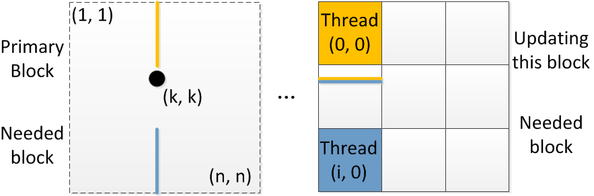


Previous implementation [Katz 2008]
Rethink: do we need sync & data share when updating a block?
  Phase 3: $C_{ij}$ needs not be shared → no sync
Phase 1 & 2
  Updating the block in Phase 1 & 2 needs this block itself, so some data are shared and synchronization is needed
Synchronization

Slide 29

Our implementation
Whole GPU for 1 block
  $n$ = block size can be large, and total data transfer is significantly reduced.
  $C_{ij}$ can stay in registers until this block finishes (Since $C_{ij}$ needs not be shared)
  Now $n$ is limited by total registers on GPU rather than registers / Computer Unit
But for Phase 1 & 2, some data have to be shared and global barrier is needed.

Slide 30
Blocked FW Performance
Unit: second
Sparsity | 0.06% | 0.13% | 0.38% | 1.39% | 5.46%
[Katz 2008] | 2510 | 2506 | 2519 | 2508 | 2499
Our implementation | 1123 | 1138 | 1113 | 1115 | 1087
Single-core CPU FW | 138830 | 138893 | 138943 | 138665 | 138607
Speed up | 123.6 | 122.1 | 124.5 | 124.4 | 127.5
4-core CPU BFS | 39 | 74 | 191 | 633 | 2430
1-core CPU BFS | 132 | 253 | 646 | 2161 | 8314
Speed up | 3.38 | 3.42 | 3.38 | 3.41 | 3.42

Slide 31

Platform Selection
If sparsity > 2.4%: BFW on GPU;
Otherwise: BFS on 4-core CPU.

Slide 32
Outline
Background and Motivation
Platform and Algorithms
Results
Conclusion and future work

Slide 33



Result: Scale free
Degree distribution (log-log plot)
Scale-free network:
$P\left(k\right)=ck^{−γ}$
Hubs exist
Notes:
In accordance with previous study.
The scale-free property strongly correlates with the network's robustness to failure. It turns out that the major hubs are closely followed by smaller ones. These ones, in turn, are followed by other nodes with an even smaller degree and so on. This hierarchy allows for a fault tolerant behavior. If failures occur at random and the vast majority of nodes are those with small degree, the likelihood that a hub would be affected is almost negligible. Even if a hub-failure occurs, the network will generally not lose its connectedness, due to the remaining hubs. On the other hand, if we choose a few major hubs and take them out of the network, the network is turned into a set of rather isolated graphs. Thus, hubs are both a strength and a weakness of scale-free networks. These properties have been studied analytically using percolation theory by Cohen et al.[5][6] and by Callaway et al.[7]
Another important characteristic of scale-free networks is the clustering coefficient distribution, which decreases as the node degree increases. This distribution also follows a power law. This implies that the low-degree nodes belong to very dense sub-graphs and those sub-graphs are connected to each other through hubs. Consider a social network in which nodes are people and links are acquaintance relationships between people. It is easy to see that people tend to form communities, i.e., small groups in which everyone knows everyone (one can think of such community as a complete graph). In addition, the members of a community also have a few acquaintance relationships to people outside that community. Some people, however, are connected to a large number of communities (e.g., celebrities, politicians). Those people may be considered the hubs responsible for the small-world phenomenon.

Slide 34


Result: high-degree hubs
http://www.cabiatl.com/mricro/mricron/images/examplefmri.jpg
Prefrontal cortex
Precuneus
parietal lobe
Notes:
Voxels with high degree are denoted by red point.
Only display the voxels near the cerebral cortex.

Slide 35


Result: modular structure
parietal lobe
http://www.science.ca/images/Brain_Witelson.jpg
frontal lobe
temporal lobe
Occipital lobe
Notes:
This is the modular structure of human brain by spectrum method.

Slide 36
Conclusion
The whole process for one subject
  1 day → 40 minutes
Applicability
  Low power consumption & low cost
  Can be integrated with fMRI machines
Scalability
  Scaling networks
  Multiple GPU
Can be used in other network analysis
  Social network
  Internet
  …
Notes:
Our platform meets the demand:
Fast
Applicable
Scalable
Reuseable

Slide 37
Future work: Understand and Diagnosis
Local efficiency of brain networks
  APSP of every sub-network, networks with diverse size / sparsity
  Dynamically choose the platform and algorithm
Combine with DT-MRI fiber tractography
  Bridge the gap between functional connectivity and structural connectivity [Honey 2010]
Scale to finer-grained: what if we should analyze the neuron?
Latency requirement: FPGA needed, on-site diagnosis, in-surgery BNA
Notes:
Future work includes integrating more network property calculation tool.
The calculation of local efficiency need the APSP result of every sub-networks.
The sub-network of each voxel is made up of its neighboring voxels and their connections.
Since the degree distribution has long tail, we need APSP of networks with diverse size. The sparsity may also vary.
Efficient calculation of local efficiency requires dynamically choose the best software/hardware configuration.
Another promising work is combing the result of fMRI and dtMRI.
By this way, we can have a more comprehensive view of the function and structtre of our brain.

Slide 38
Thank you !

Slide 39
Reference
[Heuvel 2008] M. van den Heuvel, C. Stam, M. Boersma, and H. Hulshoffpol, “Small-world and scale-free organization of voxel-based restingstate functional connectivity in the human brain,” NeuroImage, vol. 43, no. 3, pp. 528–539, Nov. 2008.
[Valencia 2009] M. Valencia, M. A. Pastor, M. A. Fern´andez-Seara, J. Artieda, J. Martinerie, and M. Chavez, “Complex modular structure of large-scale brain networks,” Chaos: An Interdisciplinary Journal of Nonlinear Science, vol. 19, no. 2, p. 023119, 2009.
[He 2009] Y. He, and Z. Chen, and A. Evans, “Structural insights into aberrant topological patterns of large-scale cortical networks in Alzheimer's disease” The Journal of Neuroscience vol. 28, no. 18, p. 4756, 2008.
[Bassett 2008] D.S. Bassett, and E. Bullmore, and B.A. Verchinski, and V.S. Mattay, and D.R. Weinberger, and Meyer-Lindenberg, A., “Hierarchical organization of human cortical networks in health and schizophrenia”, The Journal of Neuroscience, vol. 28, no. 37, p. 9239, 2008.

Slide 40
Reference
[Benjamini 2006] R. Heller, D. Stanley, D. Yekutieli, N. Rubin, and Y. Benjamini, “Cluster-based analysis of FMRI data.” Neuroimage, vol. 33, no. 2, pp. 599–608, Nov. 2006.
[He 2009] Y. He, J. Wang, L. Wang, Z. J. Chen, C. Yan, H. Yang, H. Tang, C. Zhu, Q. Gong, Y. Zang, and A. C. Evans, “Uncovering intrinsic modular organization of spontaneous brain activity in humans,” PLoS ONE, vol. 4, no. 4, p. e5226, 04 2009.
[Pons 2006] P. Pons and M. Latapy, “Computing communities in large networks using random walks,” Journal of Graph Algorithms and Applications, vol. 10, no. 2, pp. 191–218, 2006.
[Newman 2006] M.E.J Newman, “Modularity and community structure in networks”, Proceedings of the National Academy of Sciences, vol. 103, no.23, p. 8577, 2006.
[Venkataraman 2000] G. Venkataraman, S. Sahni, and S. Mukhopadhyaya, “A blocked allpairs shortest-paths algorithm,” in Lecture Notes in Computer Science, 2000.

Slide 41
Reference
[Gembris 2009] D. Gembris, and M. Neeb, and M. Gipp, and A. Kugel, and R. Manner, “Correlation analysis on GPU systems using NVIDIA’s CUDA”, Journal of Real-Time Image Processing, p. 1-6
[Katz 2008] G.J. Katz, and Jr, J.T. Kider, “All-pairs shortest-paths for large graphs on the GPU”, Proceedings of the 23rd ACM SIGGRAPH/EUROGRAPHICS symposium on Graphics hardware, p. 47—55, 2008.
[Newman 2004] M. E. J. Newman, “Fast algorithm for detecting community structure in networks,” Phys. Rev. E, vol. 69, no. 6, p. 066133, Jun 2004.
  [Honey 2010] C. J. Honey, and J. P. Thivierge, and O. Sporns, “Can structure predict function in the human brain?”, NeuroImage, vol. 52, no. 3, p. 766--776, 2010.
[He 2008] Y. He, Z. Chen, and A. Evans, Structural Insights into Aberrant Topological Patterns of Large-Scale Cortical Networks in Alzheimer’s Disease, The Journal of Neuroscience, vol.28, no.18, p. 4756—4766, 2008
[Bassett 2008] D.S.Bassett, E.Bullmore, B.A.Verchinski, V.S. Mattay, D.R.Weinberger, and A.Meyer-Lindenberg, Hierarchical Organization of Human Cortical Networks in Health and Schizophrenia, The Journal of Neuroscience, vol.28, no.37, p. 9239—9248, 2008

Slide 42
BACKUP

Slide 43
GPU-based probabilistic fiber tractography
Diffusion Tensor Magnetic Resonance Imaging
  Non-invasive measurement of the diffusion in vivo
Fiber tractography
  Reconstructing fiber bundles in the human brain
Significance
  Human connectome
  Surgical planning, neurological disorders diagnosis
Probabilistic vs. deterministic
  Robust to noise
  Handle the presence of fiber crossings, bifurcations
  Providing confidence
Notes:
Future work includes integrating more network property calculation tool.
The calculation of local efficiency need the APSP result of every sub-networks.
The sub-network of each voxel is made up of its neighboring voxels and their connections.
Since the degree distribution has long tail, we need APSP of networks with diverse size. The sparsity may also vary.
Efficient calculation of local efficiency requires dynamically choose the best software/hardware configuration.
Another promising work is combing the result of fMRI and dtMRI.
By this way, we can have a more comprehensive view of the function and structtre of our brain.

Slide 44

GPU-based probabilistic fiber tractography
Local Parameter Estimation
  P(parameters | parameterized model, data)
  Markov-Chain Monte Carlo sampling
Global Connectivity Estimation
  Probabilistic Streamlining
Need for speed
  High spatial/regular resolution
  Large samples
  Changing empirical parameters/preprocessing)
Notes:
The two most time-consuming steps of probabilistic fiber tractography are iteratively drawing samples from complicated and high dimensional
pdfs using Markov-Chain Monte-Carlo (MCMC) techniques and the subsequent probabilistic streamlining
fiber tracking based on these random samples.
The probabilistic analysis of one brain at regular spatial and angular resolution costs nearly one day on common computer workstations.
The intensive computation in the probabilistic method inhibits the research and its application in routine clinical tasks

Slide 45

GPU-based probabilistic fiber tractography
MCMC sampling: 120x speedup
Probabilistic streamlining: 50x speedup
Notes:
The framework includes two main steps: 1) Markov-Chain Monte-Carlo (MCMC) sampling to
generate random samples, and 2) probabilistic streamlining fiber tracking. On the AMD Radeon
5870 GPU, we achieve performance gains up to 120 times and 50 times over regular workstation for the MCMC sampling
and streamlining fiber tracking respectively.

Slide 46


GPU-based probabilistic fiber tractography
Reconstructed fiber pathways
corpus callosum
https://www.medical.siemens.com/siemens/en_GLOBAL/gg_mr_FBAs/images/option_images/Applications/DTI
Notes:
We select some long fibers and visualize them using MATLAB.

Slide 47


Slide 48








Our research work
1) Healthy young adults
2) Normal aging
3) Alzheimer’s disease
4) Multiple sclerosis
5) ADHD
6) OCD
7) Schizophrenia
8) Depression
9) Epilepsy
……
Structural MRI
Structural network
Cortical thickness
Diffusion MRI
White matter
Atlas
Structural network
Functional MRI
Time series
Functional network
Network Construction
Network Characterization
Network Applications

Slide 49

Network Properties

