Slide 1
Performance Analysis of Parallel Sparse LU Factorization on CPUs and GPUs
Nano-scale Integrated Circuit and System Lab.,
EE Department, Tsinghua University
Ling Ren

Slide 2
Outline
Background & Related works
Algorithm
GPU implementation
Experiments
Performance analysis

Slide 3
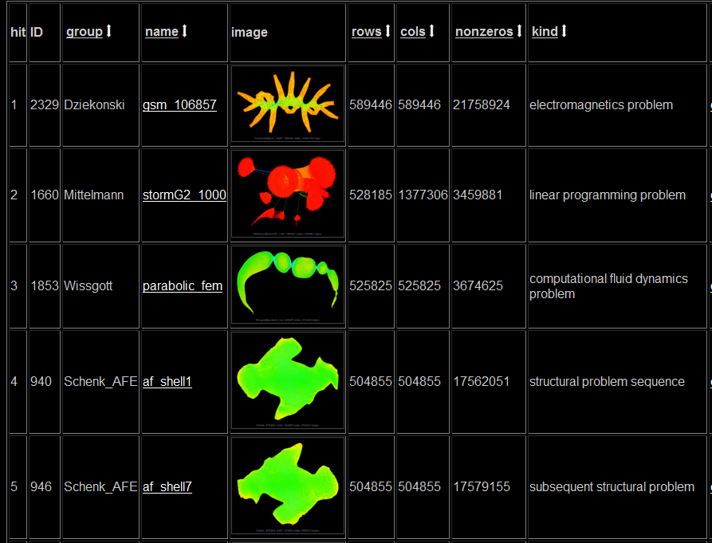
Background
Our motivation: SPICE simulator
Bottleneck : Sparse LU Solver
University of Florida Sparse Matrix Collection
http://www.cise.ufl.edu/research/sparse/matrices/

Slide 4
Related works
Dense LU
Very efficient on GPUs, [Volkov2008, Tomov2010]
Sparse LU
[SuperLU1999, Pardiso2002] Supernode (Dense blocks)
[Christen2007] dense blocks on GPU
But no supernodes in extreme sparse matrices
[KLU2010], for circuit matrices, without Supernode
G/P left-looking algorithm [G/P 1988], sequential version only
Notes:
下面我们回顾前人的相关工作。稀疏LU分解方面，有许多常用的软件，如SuperLU 和 Pardiso。这两者都基于supernode，即在稀疏矩阵中通过调换行列次序产生稠密块。但是，电路矩阵这样及稀疏的矩阵通常无法产生稠密快。因此在KLU这个为电路仿真优化的软件中，没有采用supernode思想。以上软件中，只有pardiso具有GPU版本，而且它只是在分解中，如果遇到稠密块，把稠密块的分解放在GPU上进行，其他工作仍用CPU上完成。

Slide 5
Outline
Background & Related works
Algorithm
GPU implementation
Experiments
Performance analysis

Slide 6
Algorithm – left-looking
Each column is updated by all the columns on its left
Update = vector multiply-and-add (MAD)
C is $U_{jk}$
Read + write > arithmetic
Update

Slide 7
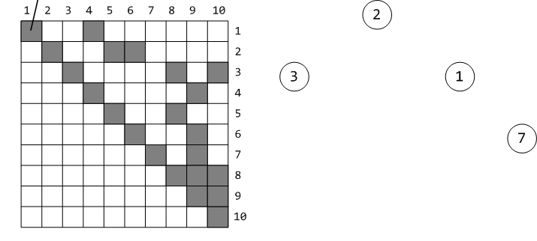
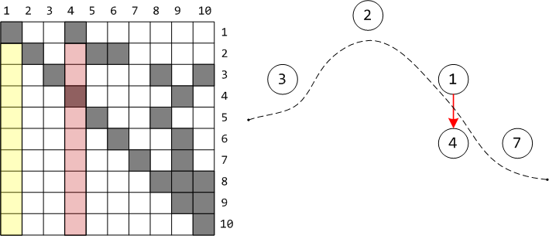
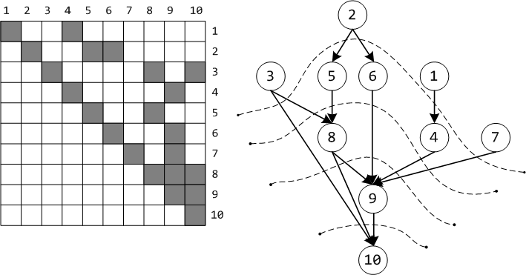
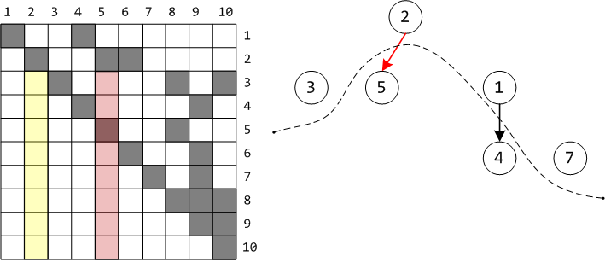
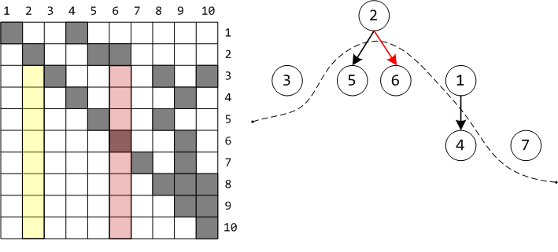
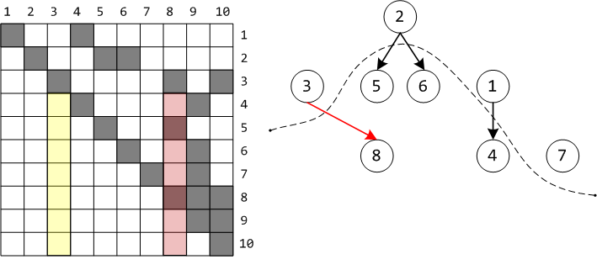
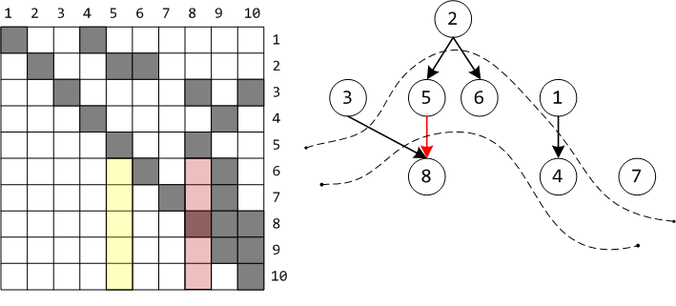
Algorithm description – EGraph
Nonzero structure of U determines the dependency
C is $U_{jk}$
nonzero
(a) Upper triangular matrix U
(b)EGraph
Notes:
下面介绍我们的稀疏矩阵LU分解。首先介绍基本算法，left-looking算法。这个算法分解第k列时，依次用它左边的所有列更新第k列。

Slide 8
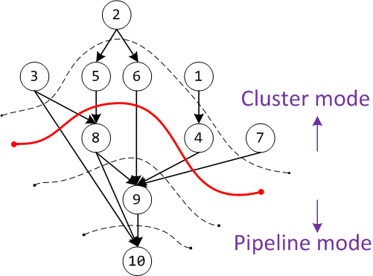
Algorithm analysis – parallelism
Divide columns into levels
Columns in the same level are independent
Cluster mode & pipeline mode
Overlapped factorization in pipeline mode
Thread 1
Thread 2
Column 1
Column 3
......
Column 2
Column 4
......
Notes:
分层，同一层相互独立
前几层好并行。
Pipeline占很大时间比例，不好并行，没人做过
串行部分很长

Slide 9
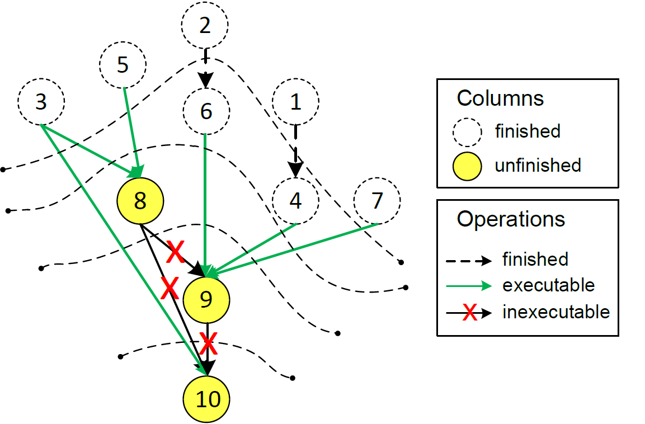
Algorithm analysis – timing order
Pipeline parallelism, along with timing order
Notes:
分层，同一层相互独立
前几层好并行。
Pipeline占很大时间比例，不好并行，没人做过
串行部分很长

Slide 10
Outline
Background & Related works
Algorithm
GPU implementation
Experiments
Performance analysis

Slide 11
Algorithm analysis – timing order
Pipeline parallelism, along with timing order
Notes:
分层，同一层相互独立
前几层好并行。
Pipeline占很大时间比例，不好并行，没人做过
串行部分很长

Slide 12
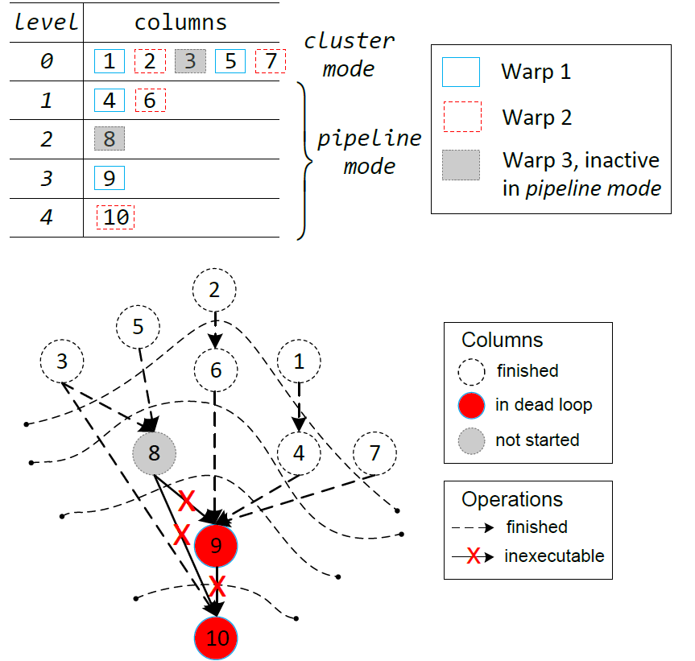
GPU implementation - avoid deadlock
Traditionally, some warps
Inactive at the beginning (limited resource etc.).
Activated when other active warps finish
But in sparse LU, all warps must be active from the beginning
Notes:
否则会造成死锁

Slide 13
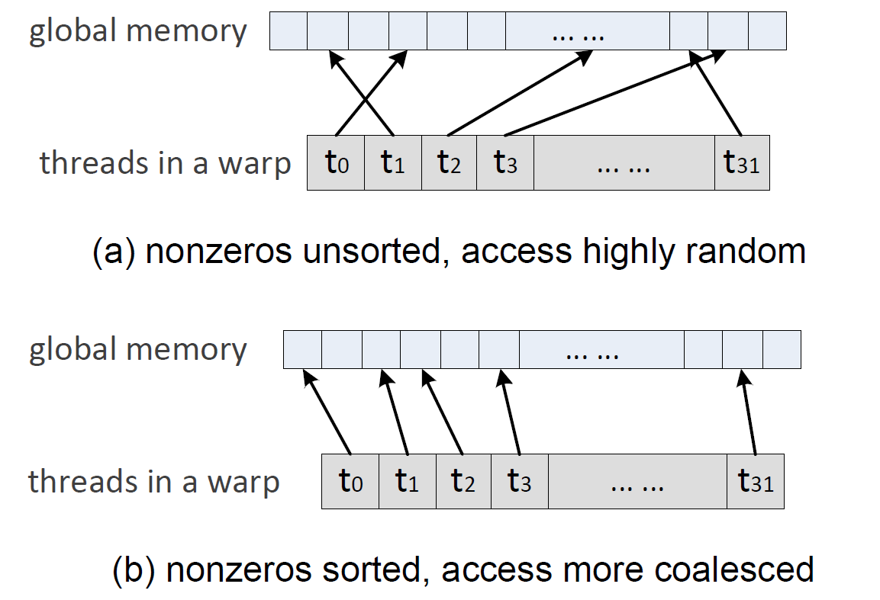
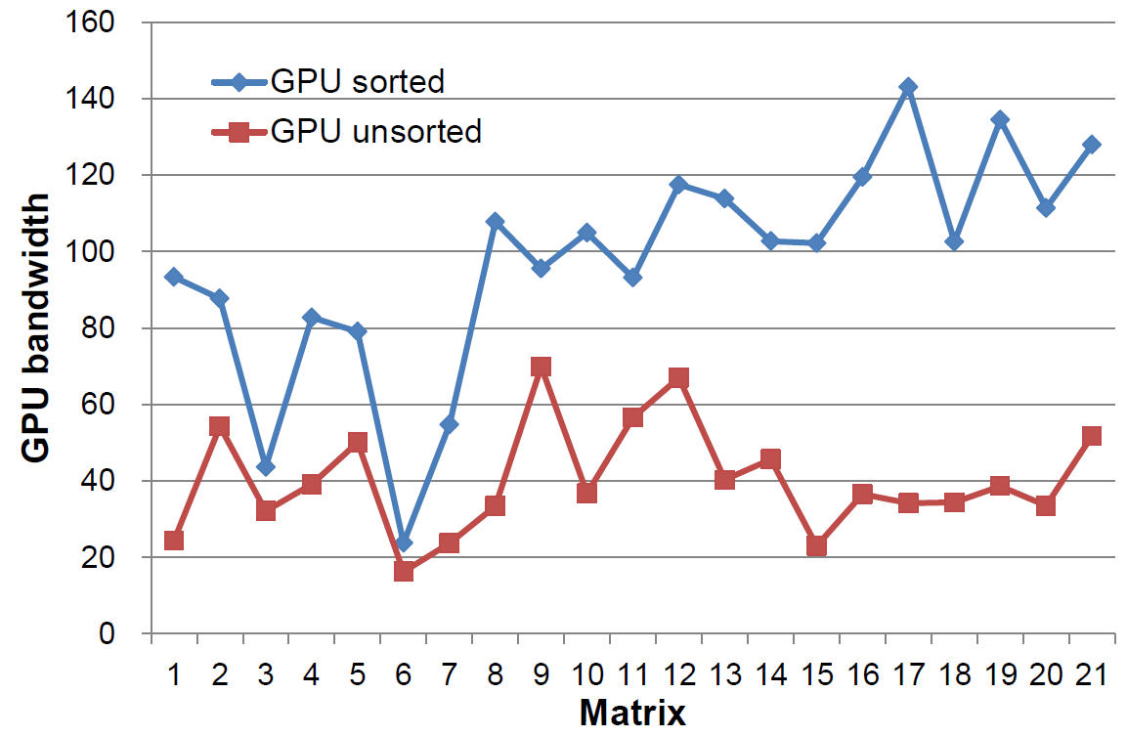
GPU implementation – data locality
Coalesced accesses
Sorting the nonzeros

Slide 14
GPU implementation – work partitioning
Two levels of parallelism
Between vector MAD & within vector MAD
Virtue group size?
Too large → idle threads, fewer virtue groups
Too small → SIMD threads diverge
Virtue group = one warp
One virtue group processes one column
# virtue groups == # concurrent columns

Slide 15
Outline
Background & Related works
Algorithm
GPU implementation
Experiments
Performance analysis

Slide 16
Experiments – setup
CPU
2 Xeon E5405
2 Xeon X5680
GPU
AMD Radeon 5870
NVIDIA GTX580
Testing matrices
University of Florida Sparse Matrix Collection

Slide 17
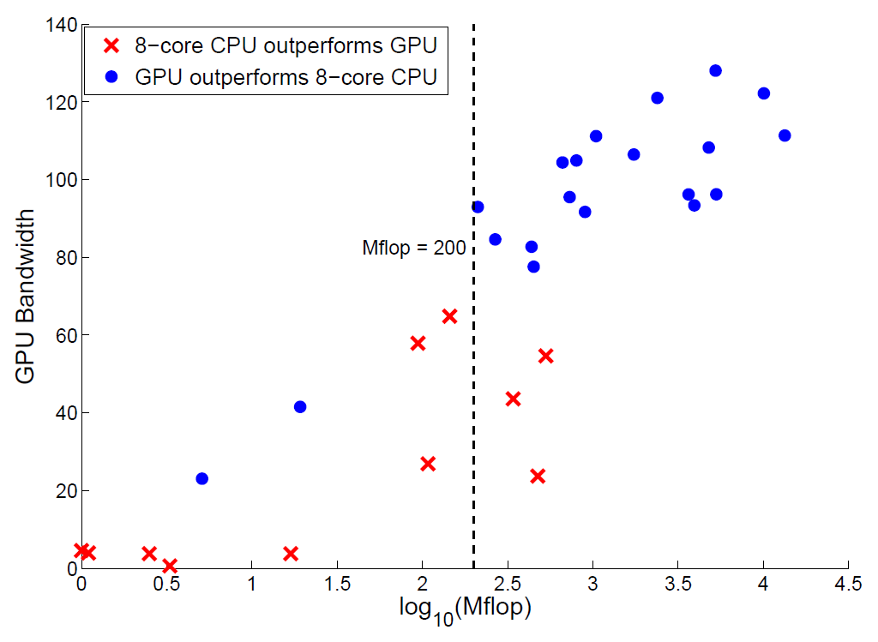
Experiments – bandwidth vs. flops
GTX580
vs.
X5680
Notes:
CPU 世界最快，也是自己实现的

Slide 18
Experiments – performance
Group A: flops < 200M
Group B: flops > 200M
Group C: denormal numbers, slow on CPU
Group | GPU Bandwidth (GB/s) | Speedup Over
 |  | 1 CPU | 4 CPUs | 8 CPUs | KLU
A | 9.68 | 1.61 | 0.77 | 0.54 | 1.88
B | 91.17 | 7.90 | 2.58 | 1.49 | 11.73
C | 81.86 | 49.72 | 12.90 | 6.77 | 45.78

Slide 19
Outline
Background & Related works
Algorithm
GPU implementation
Experiments
Performance analysis

Slide 20
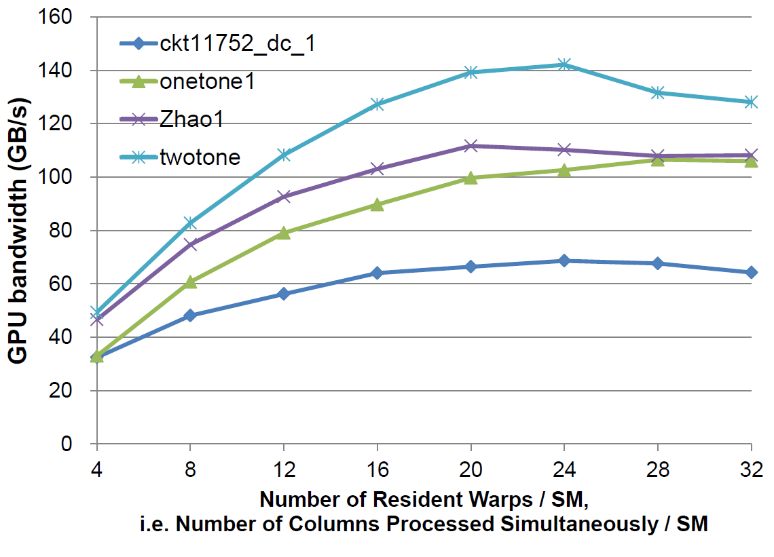
Performance analysis – concurrent columns
More concurrent columns, higher performance?
No, inexecutable operations.

Slide 21
Performance analysis – on CPUs
Cache size & speed
More cores → higher performance
CPU |  | E5405 | X5680
Number of cores |  | 2 $×$ 4 | 2 $×$ 6
Cache Size | L1 | 32KB / core | 32KB / core
 | L2 | 12MB / 4 cores | 256KB / core
 | L3 | -- | 12MB / 6 cores
Clock rate (GHz) |  | 2.0 | 3.2
Bandwidth Achieved (GB/s) | 1-core | 4.99 | 11.54
 | 4-core | 14.41 | 35.34
 | 8-core | 20.76 | 61.25

Slide 22
Performance analysis – on GPUs
Cache too small, not important at present
Only 10% performance loss, if no caching at all
Dominant factors
peak bandwidth
enough active warps to bring out the peak

Slide 23
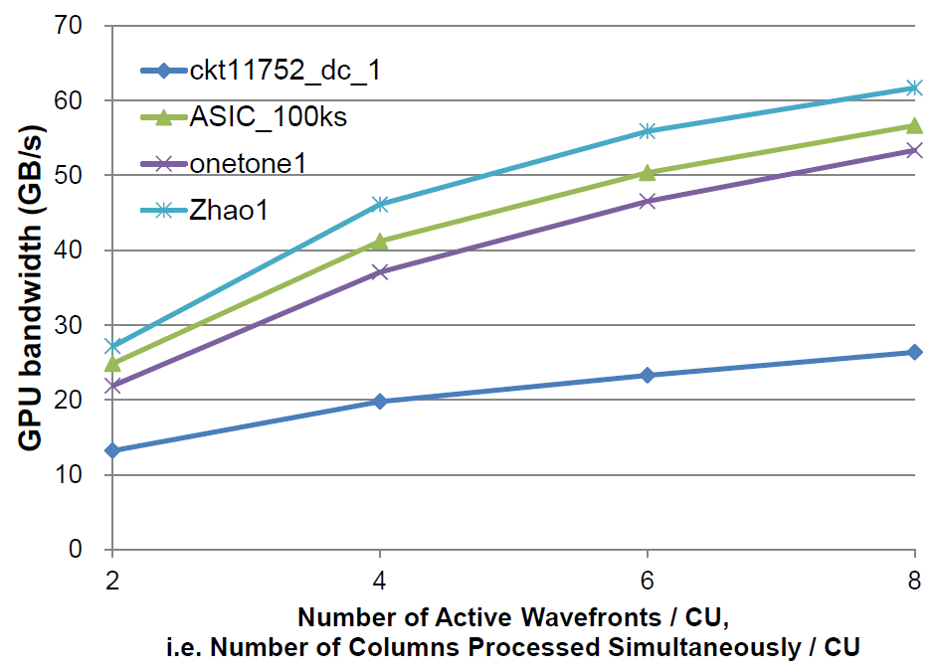
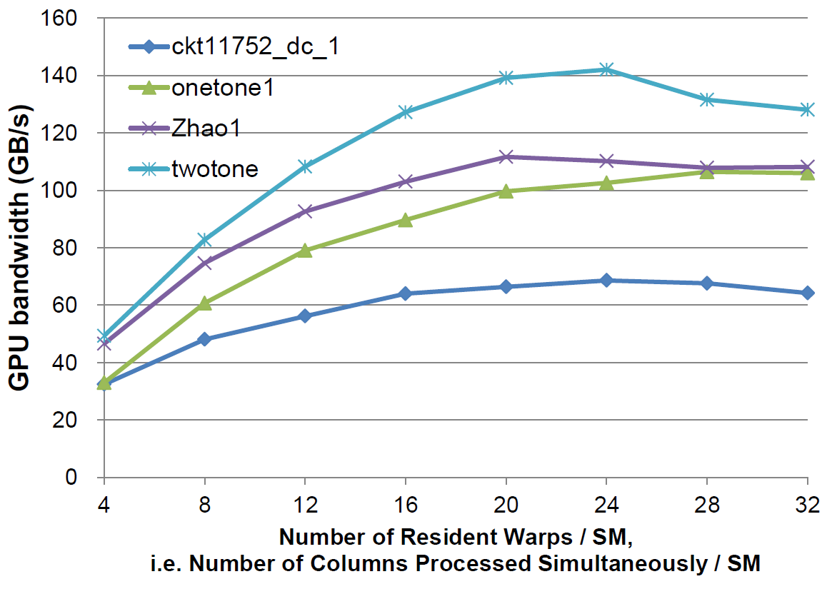
Performance analysis – on GPUs
Radeon 5870 & GTX580

Slide 24
Thank you !
EE Department, Tsinghua University
Ling Ren

Slide 25
Reference
[Volkov2008] V.Volkov and J. Demmel, “Benchmarking GPUs to tune dense linear algebra”, SC '08: Proceedings of the 2008 ACM/IEEE conference on Supercomputing, IEEE Press, 2008, pp. 1-11.
[Tomov2010] S. Tomov, J. Dongarra, and M. Baboulin, “Towards dense linear algebra for hybrid GPU accelerated many-core systems,” Parallel Comput., vol. 36, pp. 232–240, June 2010.
[Christen2007] M. Christen, O. Schenk, and H. Burkhart, “General-purpose sparse matrix building blocks using the NVIDIA CUDA technology platform,” 2007.
[SuperLU1999] J. W. Demmel, S. C. Eisenstat, J. R. Gilbert, X. S. Li, and J. W. H. Liu, “A supernodal approach to sparse partial pivoting,” SIAM J. Matrix Analysis and Applications, vol. 20, no. 3, pp. 720–755, 1999
[Pardiso2002] O. Schenk and K. Gartner, “Solving un-symmetric sparse systems of linear equations with PARDISO,” Computational Science - ICCS 2002, vol. 2330, pp. 355–363, 2002.

Slide 26
Reference
[G/P 1988] J. R. Gilbert and T. Peierls, “Sparse partial pivoting in time proportional to arithmetic operations,” SIAM J. Sci. Statist. Comput., vol. 9, pp. 862– 874, 1988
[KLU2010] T. A. Davis and E. Palamadai Natarajan, “Algorithm 907: KLU, a direct sparse solver for circuit simulation problems,” ACM Trans. Math. Softw., vol. 37, pp. 36:1–36:17, September 2010.
[Florida] T. A. Davis and Y. Hu, “The university of Florida sparse matrix collection,” to appear in ACM Transactions on Mathematical Software.
[MC64] I. S. Duff and J. Koster, “The design and use of algorithms for permuting large entries to the diagonal of sparse matrices,” SIAM J. Matrix Anal. and Applics, no. 4, pp. 889–901, 1997.
[AMD] P. R. Amestoy, Enseeiht-Irit, T. A. Davis, and I. S. Duff, “Algorithm 837: AMD, an approximate minimum degree ordering algorithm,” ACM Trans. Math. Softw., vol. 30, pp. 381–388, September 2004.

Slide 27
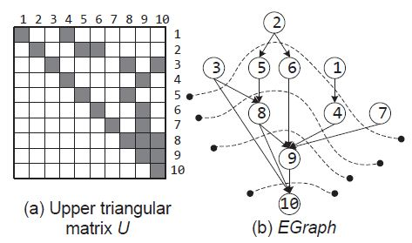
Algorithm – Terminology
Elimination Graph Definition
An edge from j to k iff U(j, k) != 0
In the following context, node = column
Level Definition
The length of the longest path from any source node to itself.
Source nodes have no incoming edges.

Slide 28
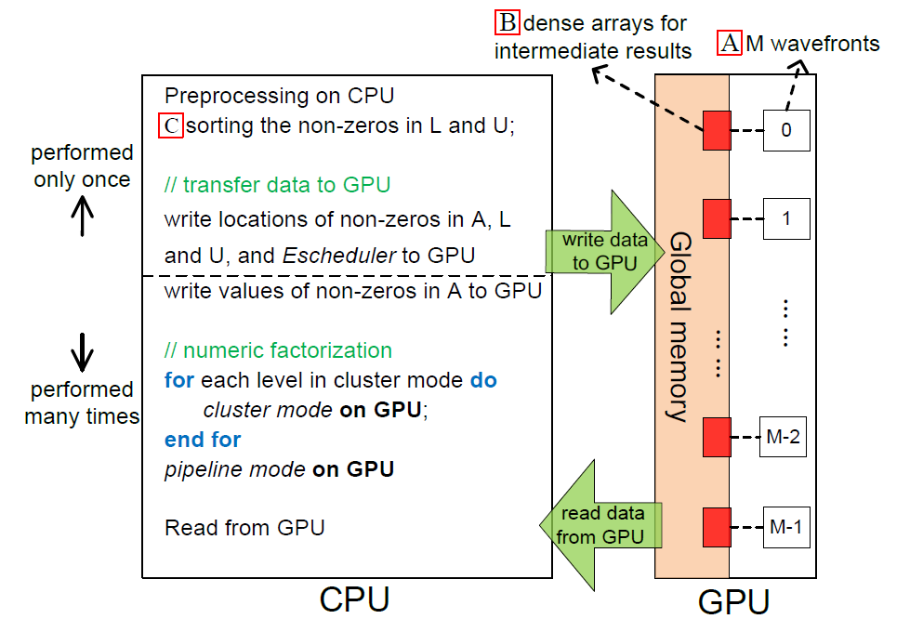
GPU implementation - workflow

Slide 29
GPU implementation - preprocessing
Preprocessing: only once on CPU
MC64 to ensure numerical stability [MC64];
Approximate Minimum Degree to reduce fill-ins [AMD] ;
pre-factorization (numeric factorization with partial pivoting) to calculate the symbolic structure of L and U.
Sorting the nonzeros of L and U

Slide 30
GPU implementation - data formats
data formats for intermediate results：
dense arrays vs. CSC
CSC (Compressed Sparse Column)
Can be put in shared memory
Using too much shared memory reduces active warps
Dense arrays > CSC format: 2.5x
Notes:
CSC 放在local memory上。通常使用…可以提高。但是

Slide 31
